Slide 1
Parent Forum
March 2024

Slide 2
Overview
General updates
Self Esteem and Toxic masculinity
SEND vision and strategy
AOB

Slide 3
SEMS survey self-esteem, relationships, misogyny & sexual harassment

Slide 4
Background
Everyone’s invited 2020
Ofsted emergency review 2021
September 2021 – Ely College review of Safer Schools – 488 responses
  Generally positive but lack of confidence in reporting and sexist language not being challenged enough
A 2021 Ofsted review of sexual abuse in schools and colleges reported that “sexual harassment occurs so frequently that it has become ‘commonplace’” and that some children “see no point in reporting them”.¹
Nationally, 92% of girls and 74% of boys said sexist name-calling happens ‘a lot’ or ‘sometimes’ to them or their peers.
Nationally, 62% of girls and 24% of boys reported unwanted touching

Slide 5
Recently
Student experience survey – Nov 23
  964 responses (70%)
  7% report not feeling safe in college
    Crowded areas – particularly corridors
    Toilets not clean enough
  85% say college encourages them to respect people from other backgrounds (12% neutral, 2% negative)
  11% report not enjoying school
Notes:
WGS 1451 students 27%
8% not feeling safe in college
86% respect – (7% neutral – 6% negative)
Enjoy school – 11%
NBS 1037 students 25%
Not safe – 4%
Respect – 92% (5 neutral – 2% negative).
CHA
1292 – 27% response rate
Not safe – 6%
Respect 83% 6% negative

Slide 6
SEMH
Survey Jan 2024 – collect views on school culture, self-esteem, relationships, misogyny, sexism and sexual harassment
869 students completed (62%)
  Male 433
  Female 418
  Other 18

Slide 7
Findings
We asked Ely College students about sexism and sexual harassment at our school, and this is what they told us:
39% of male students and 64% of female students said they had felt treated unfairly because of their gender.
17% of boys and 18% of girls said they have experienced some unwanted sexual contact at school (compared to 24% of boys and 64% of girls nationally).

Slide 8
Findings
58% of boys and 64% of girls said they experienced sexual comments, noises, gestures or ‘jokes’ at school (compared to 55% of boys and 80% of girls experiencing ‘unwanted or inappropriate sexual comments’ nationally).
55% of boys and 58% of girls said they have experienced sexist slur (compared with 74% of boys and 92% of girls having experienced or witnessed sexist name-calling nationally).

Slide 9
Findings - Friendships
Our male and female students reported similar views on their relationships:
51% of our male students and 53% of female students reported feeling confident talking about their feelings with their friends.
77% of boys and 78% of girls felt supported by their friends.

Slide 10
Self-esteem
Boys reported generally higher levels of self-esteem:
59% of boys and only 38% of girls reported feeling comfortable with the way they look
Older girls feel generally less confident than younger girls.
Only 11% of non-binary or gender fluid students reported feeling comfortable with the way they look.
54% of boys and 41% of girls reported that the social media content they consume makes them feel good about themselves.

Slide 11
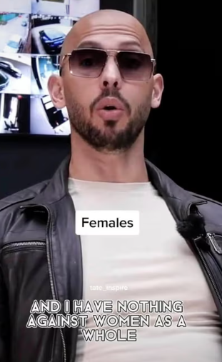
Online Misogyny
“[There is] no such thing as an independent female.”
“If I have responsibility over her, then I must have a degree of authority […] You can’t be responsible for a dog if it doesn’t obey you.”
“Depression isn’t real.”
“You feel sad, you move on… You will always be depressed if your life is depressing.”

Slide 12
Findings - Misogyny
92% of male students and 81% of female students were familiar with at least some of Tate’s content.
Girls had a generally negative view of Andrew Tate.
20% of boys had a positive view of Tate (compared to 23% of boys aged 13-15 nationally¹)
25% of boys expressed a neutral or mixed opinion.

Slide 13
Findings - Misogyny
the number of boys agreeing with Tate on how women should be treated dropped to 6% (compared to 13% nationally)
42% of boys disagreed with Tate’s views on how women should be treated.
44% of boys (compared to 33% nationally) reported that they agreed with Tate’s views on work and success
29% of them (compared to 28% nationally) agreed with his views on masculinity and what it means to be a man.
Our results show that older male students are more likely to agree with Tate’s views.

Slide 14
What next…
Whilst some students’ responses paint a reassuring picture compared to national statistics – we are committed to students feeling safe. We will continue to tackle sexism, misogyny, and harassment at college.
We are also committed to ensure that all students should receive appropriate mental health support.

Slide 15
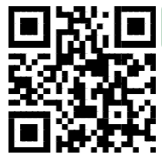
Help for parents/carers
If you want to have a conversation with your child about Andrew Tate but are not sure where to start? Scan the QR code to download a parents’ toolkit

Slide 16
SEND

Slide 17
Some context…
Currently 59 EHCPs on roll – approx. 66 in Sept 24
National EHCP 2.2% Ely has 3.6%
SEND support without EHCP nationally – 11.2% Ely has 23%
In 2019 we had 9 EHCP students
In 2021 this had grown to 21 students

Slide 18
Appropriate provision for difficulties with
Mild and moderate learning
Speech, language and communication
Autistic spectrum
ADHD
Dyslexia, dyscalculia and dyspraxia
SEMH
Range of medical disabilities

Slide 19
MERIDIAN SEND POLICY
Wave 1
Wave 2
Wave 3
Quality first teaching
Adaptive strategies
Short term intervention – 6 to 12 weeks
Evaluated with child and parents
ADPR formalised to document child’s needs, provision and progress
SENDCO involvement
SEND register K
SEND caseworker with SENDCO involvement
Wave 4 (EHCP)
All students have EHCPs
SENDCO ensures all provisions are in place
Additional external funding to provide support

Slide 20
Expectations
Students with SEND are…
Known and their needs understood by pastoral and teaching staff
Adaptions within the classroom are typical and regularly used
Students make expected progress
Students are happy, safe and pride members of Ely College
Parents feel supported and confident that their child will succeed and be happy here

Slide 21
How are we doing?
Strengths
26 TA’s – wide experience
Excellent SENDCO and support staff
Recent SEND review very positive
Ralph!
Evolve
Reading Intervention is exceptional
Improvements
Progress made with ProvisionMap tool
Dedicated CPD time to SEND awareness – specific students / Autism
Quality first with Wave 1 and Wave 2 students by sharing effective strategies and knowledge
Communication

Slide 22
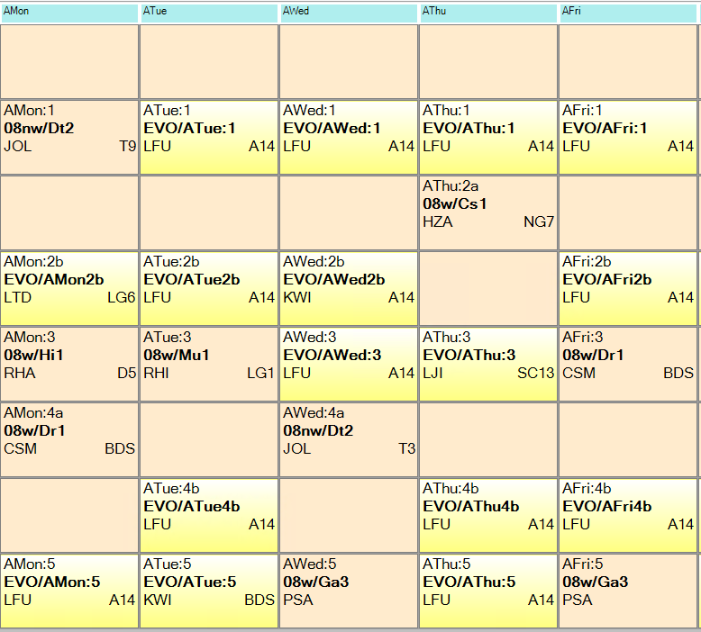
Evolve……Aspire
12-13 students – needs mean that they have struggled with mainstream provision
Mainly year 7-8 (1 year 9 student recently joined)
Hugely complex hybrid timetable – one main full-time teacher supported by 2 TAs
Use therapeutic support to support wellbeing, interactions with others and self confidence
Students still attend mainstream lessons (drama/PE/Tech/Music)
Recent SEND review highlighted
“It was a pleasure to observe how calm, relaxed and engaged CYP in the Evolve provision were.”

Slide 23
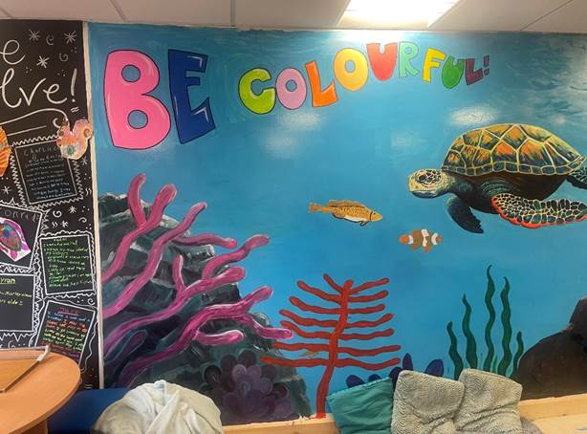

Slide 24
Reading at Ely
Support those students who struggle with reading
Identified 12 students in year 8 (wide range of data)
4 fiction reading lessons during tutor time
two disciplinary literacy lessons each week
regular contact with parents – coffee morning as well as academic mentoring
research based plan

Slide 25
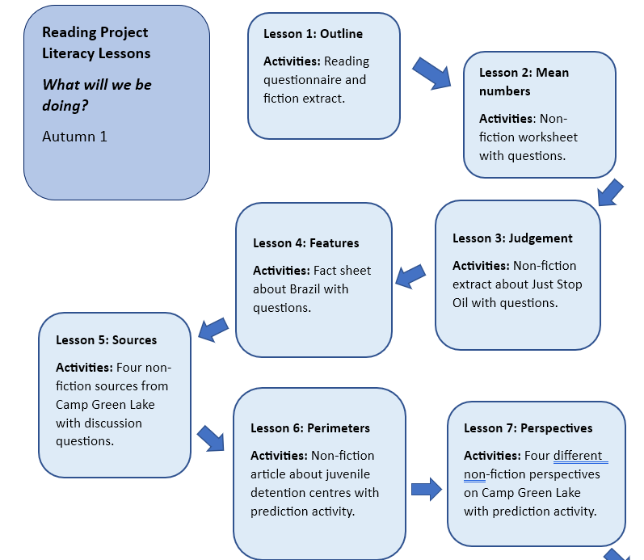

Slide 26
What have we found?
75% students have made more progress than expected in back to back NGRT tests
50% made much higher than expected progress
12 students average increase in months for reading age was 35.75…….for a one term intervention
Now working with a year 7 group of students to see if the impact can be replicated

Slide 27
What are we working on….
Recruit an assistant SENDCO
Move bases to BLSF – rebrand
Communication review – next steps parent working group
Improve awareness of child needs and how effective teaching can support

Slide 28


