Slide 1


Successful
LIVE Online Sessions
Parent and Student Guide

Slide 2
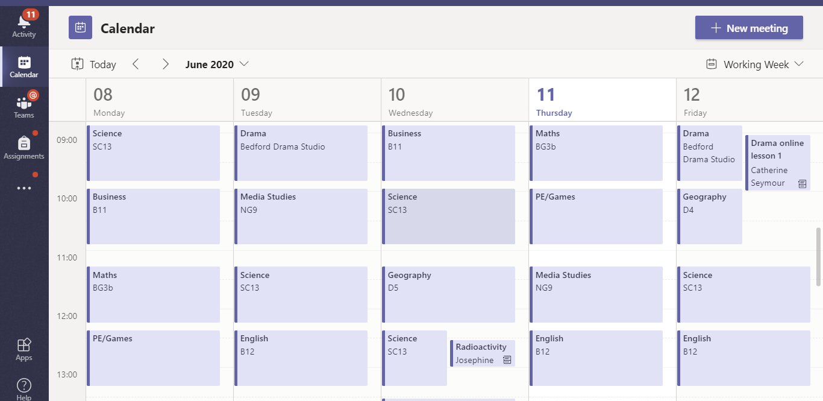
Where to find scheduled LIVE sessions…
In TEAMS students should click on the calendar icon on the left menu bar
LIVE sessions can take place after 3pm for some subjects but most will be in their usual timetable lesson slot
They will see their usual in school timetable. Any additional meetings are LIVE sessions
Check daily as LIVE sessions can be added or changed during the week
LIVE sessions are recorded so can be watched again later. The recording will appear on the class TEAMS page after the session

Slide 3


How parents can support LIVE sessions…
Encourage your child to prepare for the session – set up in a quiet space, have paper and a pen ready to take notes, have any prepared work linked to the session with them
During the session encourage them to take notes on what is being taught and contribute questions and ideas through the chat option
After the session has finished encourage them to revisit the learning and complete the assignments set. A recording of the session will be available on the class TEAMS page shortly after it finishes
If you have any questions about the content or delivery of the lesson please email the teacher after the session – Teachers will not interact with parents during the LIVE session. Please don’t make yourself audible or visible during the session

Slide 4

How students can get the most from the Live Sessions…
Start with your microphone muted – click here to mute it. A line will show through it when muted. You will need to unmute to answer any questions.
Ensure the video is off – Click here to turn it off. A line will show through it when it is off.
Please note the session will be recorded to share with other students and teachers
During the session take notes and ask questions on anything you don’t understand – Teachers want to see you engage with the session!
To raise your hand when asked to by your teacher (or to put it back down) you click here.
To submit a question or contribute an idea click here and type it in the chat log. Do NOT chat about things unrelated to the lesson.

